Slide 1
DIGITAL FILTERING USING FPGA
Group 6: Alex, Heewon, Vanshika, Yash

Slide 2
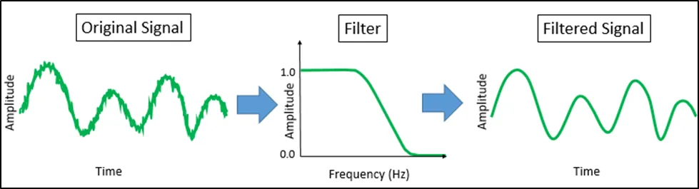
WHAT IS FILTERING
Removing unwanted frequencies (noise) from your signal by either reducing or amplifying certain frequencies.
Notes:
10 sec (V)

Slide 3
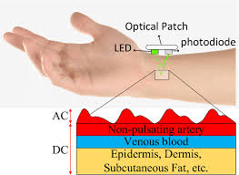
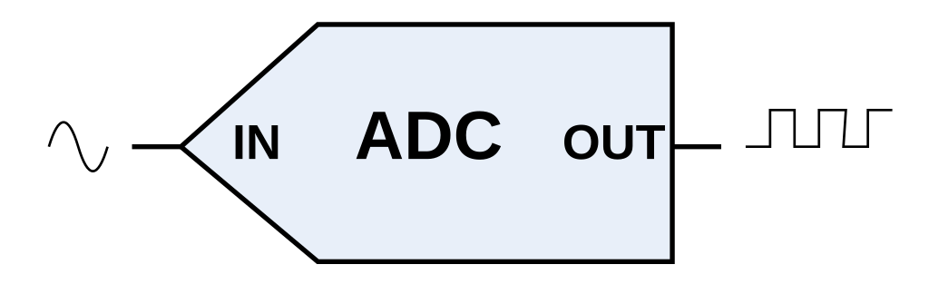
ANALOG VS. DIGITAL
Analog filters are made of physical components such as resistors, capacitors, inductors, and operational amplifiers.
Digital Processing
Analog Filtering
Analog Filter
Digital Filtering & Processing
Digital Filtering
Advantages of Digital Processing
Flexibility: Hardware can easily be reprogrammed allowing for easy testing and optimization of different filters (no modification of hardware needed)
Cost-Effectiveness: The same hardware (ADC and processing unit) can be mass-produced and reused for multiple filtering applications, reducing manufacturing costs.
Notes:
30 sec (V)

Slide 4
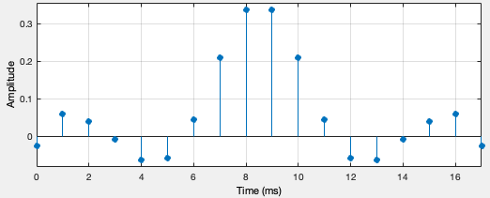
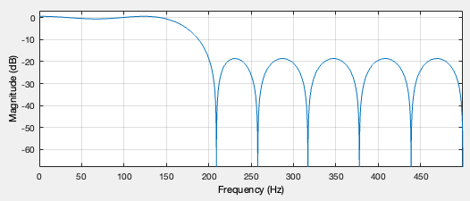
DIGITAL FILTERS
Digital filters use a digital processor to perform numerical calculations on values of the signal.
Only 18-Points!
Attenuate specific frequencies
Impulse Response
Frequency Response
For the same filter specifications, much simpler filter implementation!
Based on convolving your sampled input signal with the filter impulse response
Can be implemented as a cascade of Second order sections (SOS)
Designed using MATLAB: [Digital] Filter Designer
Notes:
20 sec (V)
Convolutions — using impulse response
Two ways to filter and process signal
Convolutions (convolve signal with impulse response)
Mention Second Order Section basic building block in digital signal processing used to implement more complex filters by cascading multiple second-order sections together;
SOS (similart to convolving w. Impulse response but uses additional output data as well)

Slide 5
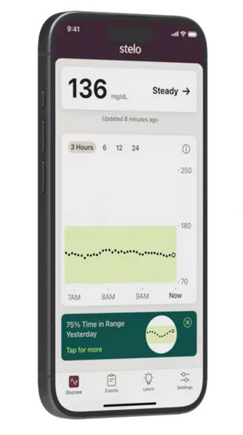
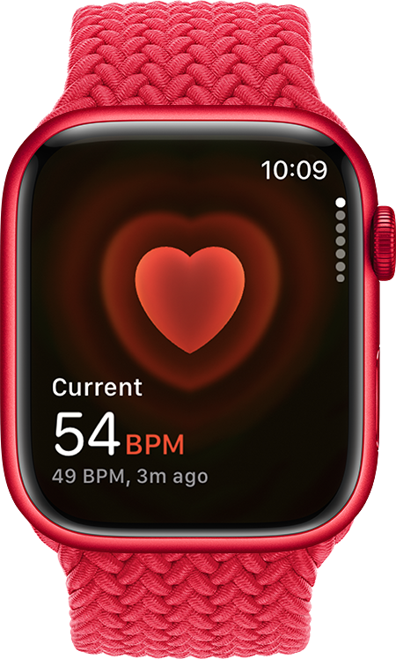
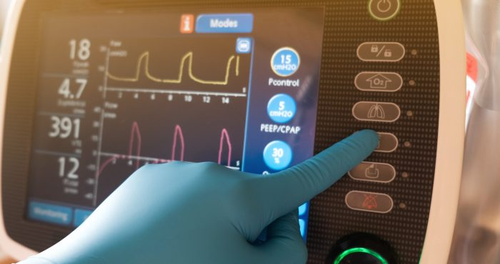
APPLICATIONS
Digital filters have a variety of biomedical applications as they enhance the quality of physiological signals for accurate diagnosis and monitoring.
Source: Stelo by Dexcom
Wearable Health Devices
Enhancing signal quality in devices like fitness trackers, glucose monitors, and heart rate monitors by reducing environmental noise.
Electrocardiogram (ECG) & HR Signal Processing
Filtering noise from ECG signals to improve the accuracy of diagnosing heart conditions
Source: Apple
Notes:
20 sec (A)

Slide 6
DESIGN SPECIFICATION AND CONSTRAINTS
Fixed Point Representation and Arithmetic for Integers
Digital Filtering (specifically S.O.S.)
Full-Duplex UART Communication with MATLAB
8-bit signed integer numbers
Module should function either as a second order section and convolutions to implement designed digital filter.
Receive and transmit 16-bit signed, floating numbers (no parity)
FIFO Buffers: provide temporary storage to data
1-Bit Sign
7-Bit Exponent
Constraints
Floating point representation — only integers implemented in filter at this moment
FPGA board compatibility with UART
Notes:
Time elapsed: 4:00 minutes
30 sec (V)

Slide 7
BLOCK DIAGRAM
MATLAB
UART
UART
Digital Filter Convolution
FIFO
FIFO
Digital Filter SOS
Notes:
30 sec (Y)
Just how the data flows
Start to finish

Slide 8
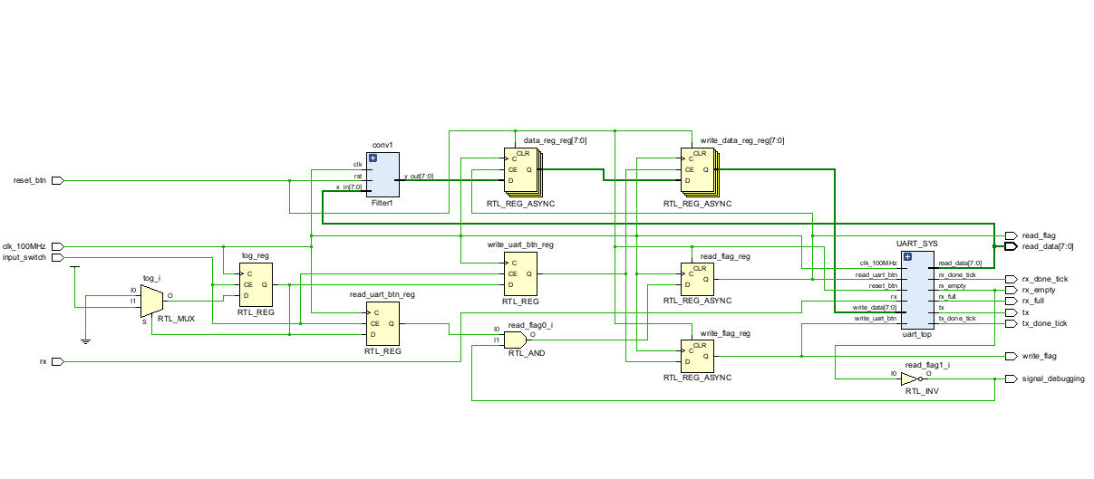
Filter module
UART Communication Module
VERILOG GENERATED BLOCK DIAGRAM
Notes:
Y
Here is the verilog generated block diagram
You can see one filter module connected as well as the uart communication modules.
One thing to point out is that here hte mux and demux were not implemented yet so only on filter module can be used (either SOS or convolution)

Slide 9
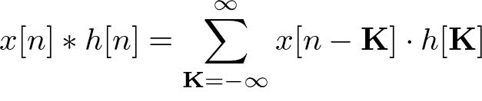
FILTERING USING CONVOLUTION
Y (Filtered Data)
X[n-1]
X[n-2]
DFF 1
DFF 1
X
DFF 1
Store upto n past values
X[n]
β2
Full Adder
Full Adder
β1
Perform convolution with n stored coefficients
β0
Notes:
15 sec (H)
In this convolution process, the input signal is delayed by ‘n’ intervals, as illustrated in the diagram with x[n-1] and x[n-2], indicating two time-step delays. Each delayed input is then multiplied by specific coefficients. These products are subsequently summed using the full adders depicted above, facilitating the state machine’s computation and outputting the convoluted signal one value at a time.
Able to use n number of coefficients and n number of bit widths of the coefficients

Slide 10
FIR FILTERING USING S.O.S
Y (Filtered Data)
X[n-1]
X[n-2]
β₀​x[n] + β₁​x[n−1] + β₂​x[n−2] − α_{1​}x[n−1] − α₂x[n−2]
β₀ ​, β₁​ , β_{2 ​}, α_{1​} , α₂ — Input Parameters
x[n-1] — 1st previous value
x[n-2] — 2nd previous value
DFF 1
X
DFF 1
X[n]
β2
Full Adder
Full Adder
α2
β1
Full Adder
α1
Full Adder
β0
Notes:
Time elapsed: 4:00 minutes
(H)
Number of Coefficients is predetermined
User is able to only change the coefficient bitwidth
Uses 2 previous inputs and 2 previous outputs

Slide 11
BLOCK DIAGRAM
MATLAB
UART
UART
Digital Filter Convolution
FIFO
FIFO
Digital Filter SOS
Notes:
30 sec (Y)
Just how the data flows

Slide 12
UART
UART stands for Universal Asynchronous Receiver and Transmitter and is a serial communication interface that allows data to be transmitted and received one bit at a time over a single data line
Key Components
Baud Rate Generator
UART Transmitter
UART Receiver
FIFO Buffers
Data Reception
Data Transmission
Incoming serial data line (rx)
write button
write_data
UART Receiver
Tx FIFO
FIFO
Synchronously samples and reconstructs this data into a byte once the start bit is detected
Stores data words to be transmitted when the transmitter is ready.
Stores 8-bit numbers and queue depth is 2⁸
If the FIFO is full, no new data can be written
Senses not empty
rx_done_tick asserted
UART Transmitter
Begins serial transmission
Sends a start bit
Sends the data bits, LSB first
Sends the stop bit(s)
Rx FIFO
Stores data until the system reads it (user presses button for output and removes from queue)
tx_done_tick asserted
Notes:
(30 sec)
If start time is : 5:00 minutes talk normal
Talk time:
Key components
Implementation of FIFO for data buffering
And use of flags to trigger data reading and transmission.

Slide 13
BLOCK DIAGRAM
MATLAB
UART
UART
Digital Filter Convolution
FIFO
FIFO
Digital Filter SOS
Notes:
30 sec (Y)
Now we are going to talk a little about he convolution filter module

Slide 14
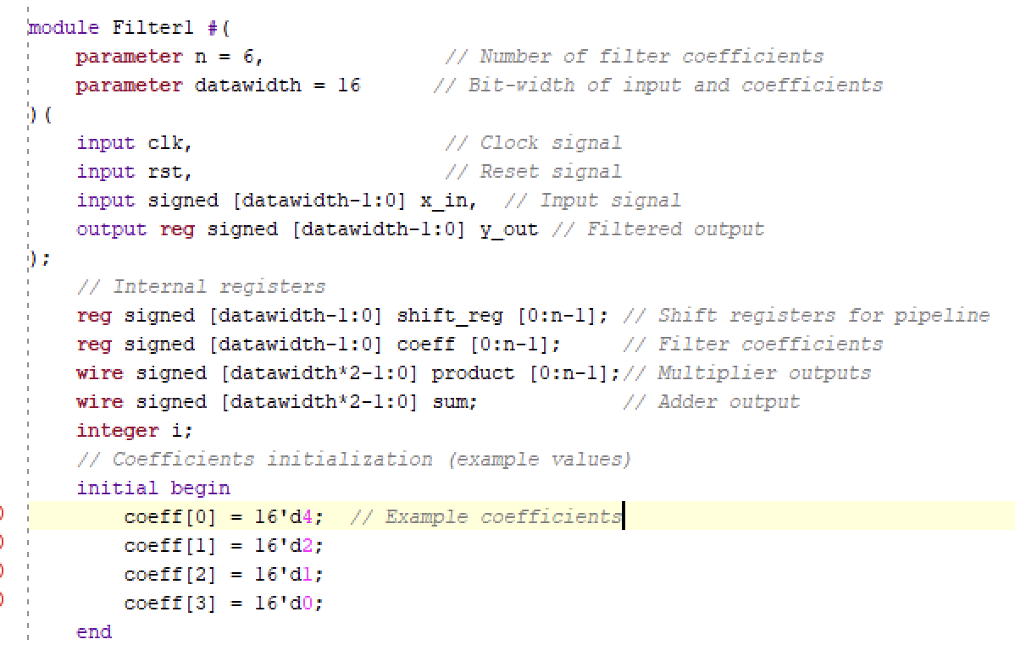
CODE SNIPPET
Convolution Filter Module
Filter Size + Precision of Arithmetic is Parameterized
Notes:
Verilog Code-Heewon

Slide 15
RESULTS
Expected Output Length
N = (6+3) - 1 = 8
Input: 6-point signal
Filter: 3-point signal
Output: 8-point signal
y[n] = [-8 -20 -42 -84 88 -80 96 64]
X[n] = [2 4 8 16 32 64]
x[n]
h[n]
y[n]
h[n] = [-4 -2 -1]
Notes:
Matlab code – heewon

Slide 16
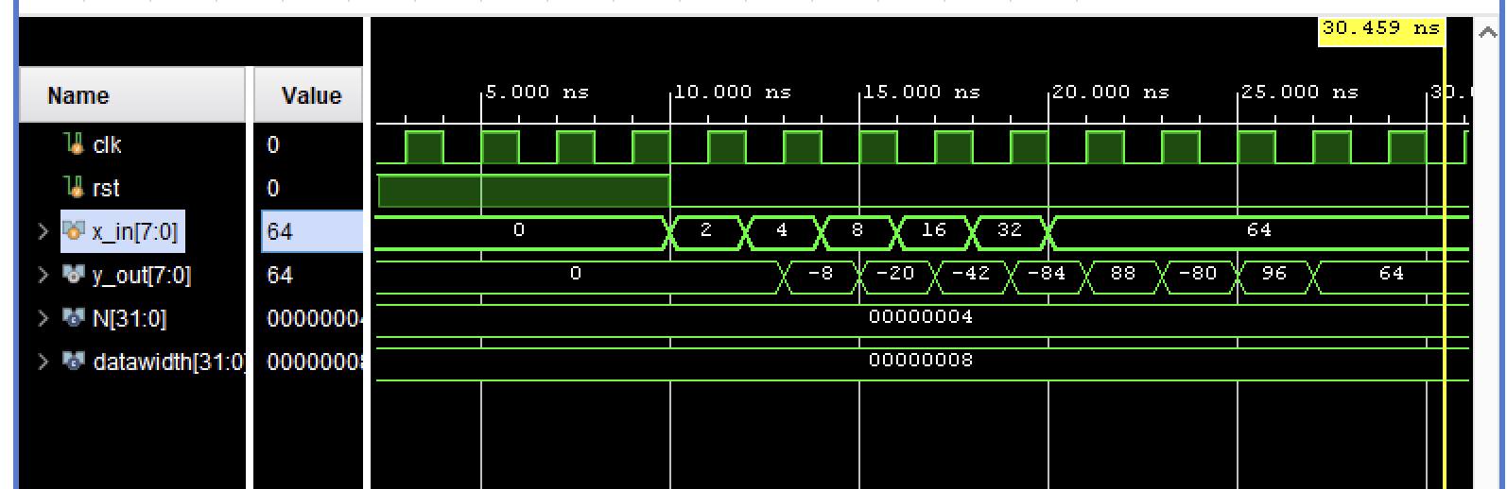
Convolution filter Testbench
Input Signal x[n]: 10-point box
Filter: Simple 3-point convolution
Expected Output y[n]
*
=
1
9
Input
Output
Notes:
H
As shown in the testbench you can see the inputs and outputs
The inputs 2,4,8,16,32,64 is then convolved to the correct outputs shown in the testbench
Parameters changed in such a way that output delayed by two values — as we changed the coefficients to 0 0 10 0 (which also scales up the values by 10). Since we scaled by 10, we need to rep the numbers with larger data bit – changed to 16
Output should be convolved with 0 0 10, output is our input 2 values ago – delayed by two and times 10
Delayed by 2 and multiplied by 2
While it worked here, there are some concerns with this code. While the previous code was properly paramterized, this code is not as adjustable yet, resulting in truncation errors on the FPGA

Slide 17
BLOCK DIAGRAM
MATLAB
UART
UART
Digital Filter Convolution
FIFO
FIFO
Digital Filter SOS
Notes:
30 sec (Y)
Now we will show a demo of the functionality of the UART communication protocol along with the SOS filter implementation.

Slide 18
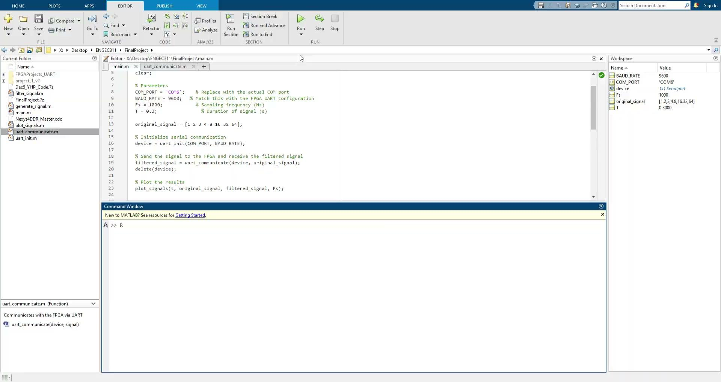
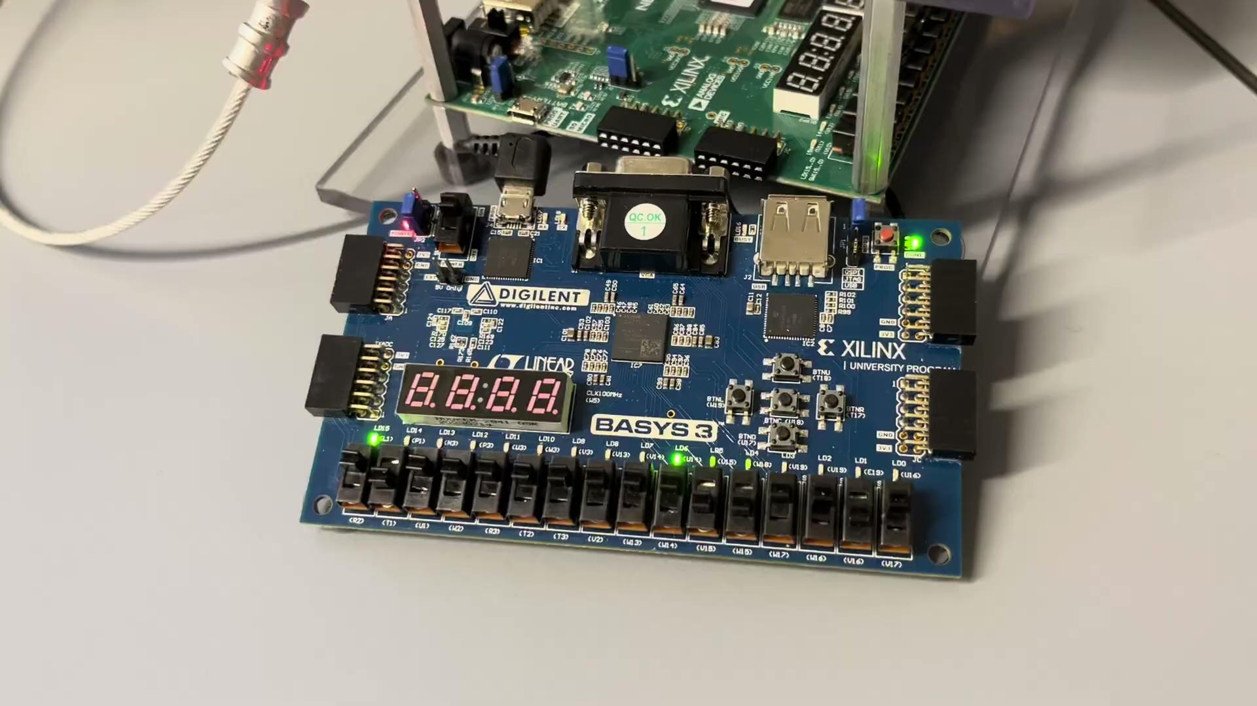
Demo of FIR Filter (SOS) Function
Notes:
Leave 1.5 minutes for future slides
Y
UART Works
SOS filter not working due to overflow, causing the filter to multiply by two instead of implementing the programmed SOS filter.

Slide 20
SUCCESSES
Currently is able to receive and transmit data
The SOS filter and convolution filter are able to adjust to different signals, able to vary with the number of coefficients and number of bits that represent the coefficients numbers
Convolution Module Verified in Testbenches
Notes:
45 sec (A)

Slide 21
FAILURES
Floating point numbers not fully verified and implemented
Optimization for Speed (delay in code in form of debouncers)
Full Duplex-UART (using a buffer for now)
SOS Filter (truncation and overflow is causing the error in the output)
Not storing the filtered data correctly on the FPGA, resulting in incorrect data being transmitted.
Notes:
45 sec (A)

Slide 22
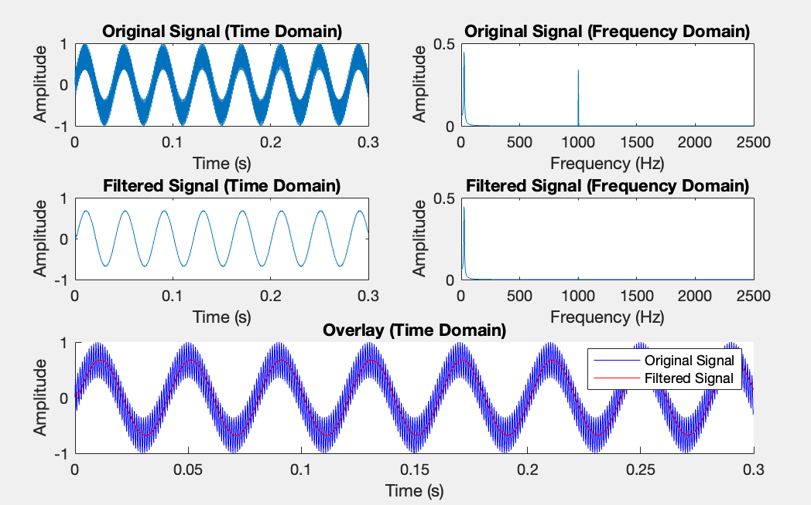
FUTURE DIRECTIONS SLIDE
Mux to control between convolution and SOS — right now we need to program in separately
Being able dynamically program filter coefficients.
And implementing floating points
Notes:
45 sec (V)
Don’t have to regenerate bitstream every time

Slide 23
Questions?
Digital Filtering using FPGA
ENGEC311: Final Project
Group Members: Alex, Heewon, Vanshika, Yash

Slide 24
Supplemental Information

Slide 25
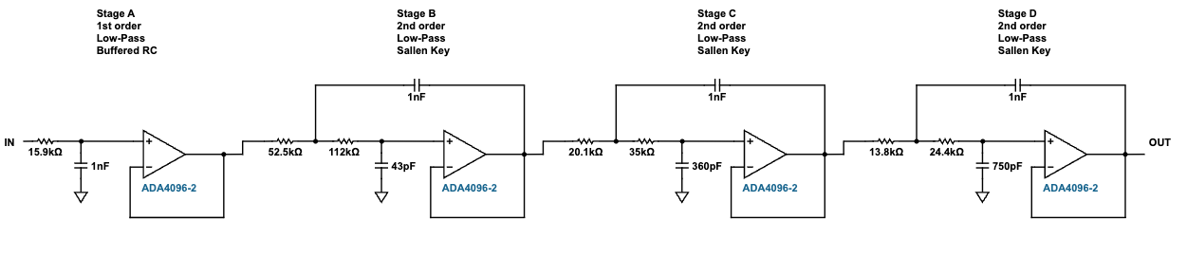
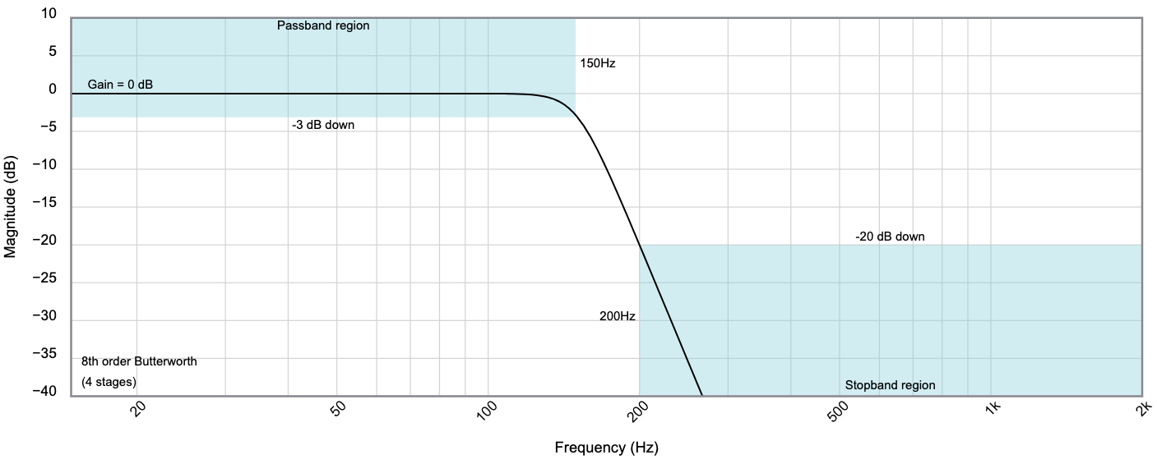
Analog Filter
Very complex and hard to build
Tolerances of Resistors and Capacitors used need to be very low increasing cost and development time.
Designed using
Analog Devices: Analog Filter Wizard

Slide 26
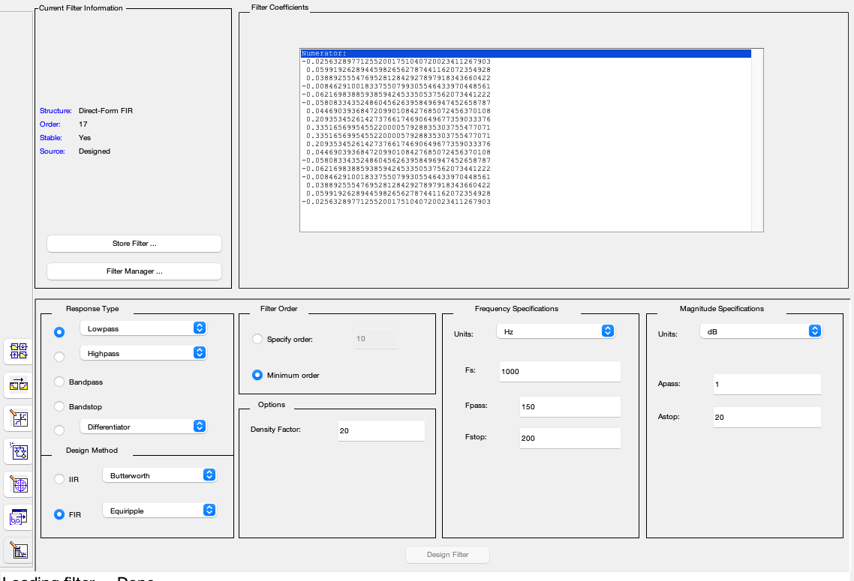
Filter Specs

Slide 27
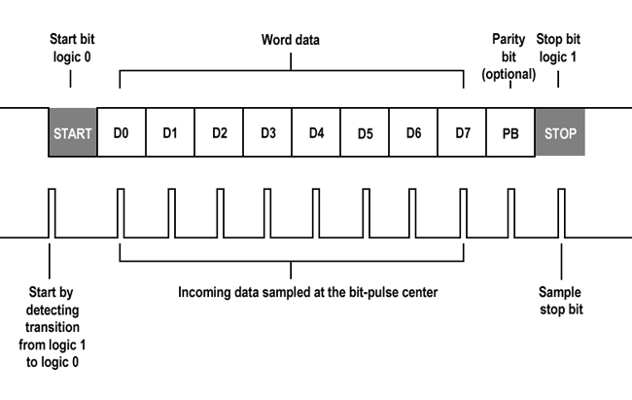
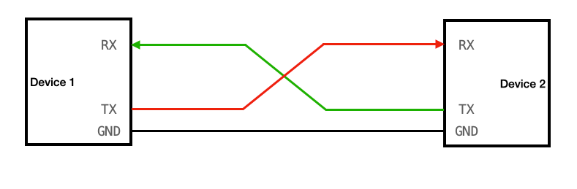
UART: Universal Asynchronous Receiver/Transmitter
UART will take transmit data 8 bits at a time
This is not a clocked communication protocol, meaning both devices must ‘talk’ as the same speed (Baud Rate, bits per second)

